Slide 1
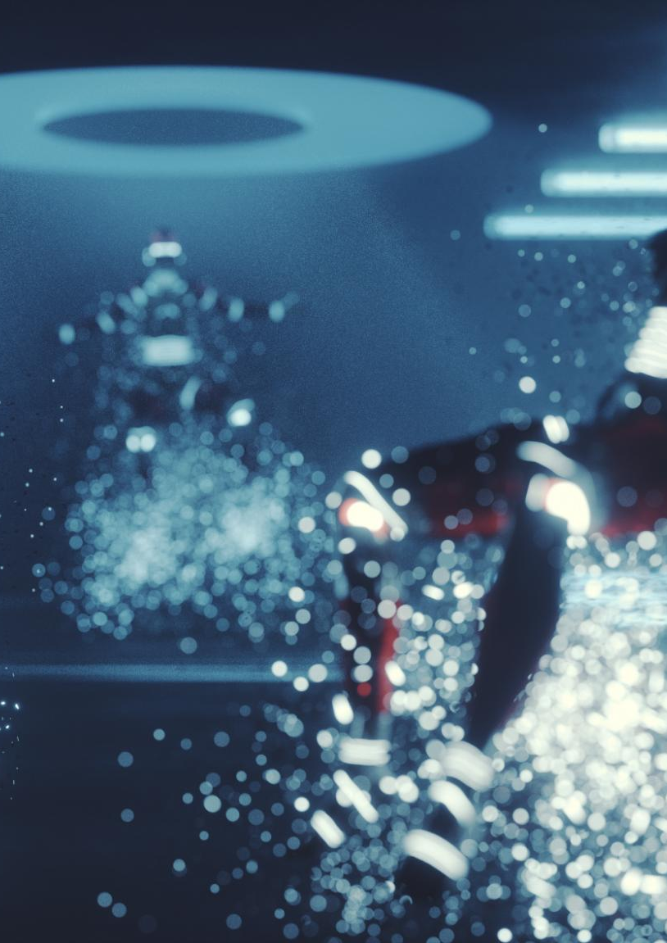
AI in Space How Artificial Intelligence is Transforming Space Exploration
Alfredo Garza, Richard Rodriguez, Olaleye Bakare, Khizar Khan
16-Jun-2025
Notes:
AI has transformed space exploration by providing autonomous decision-making capabilities, processing vast sensor data, detecting anomalies, and optimizing operations. Real-world examples like NASA’s Mars Rovers, CIMON, and AI-powered telescopes illustrate the significant impact of AI in advancing our understanding and exploration of space. Let’s Dive into AI in Space!

Slide 2
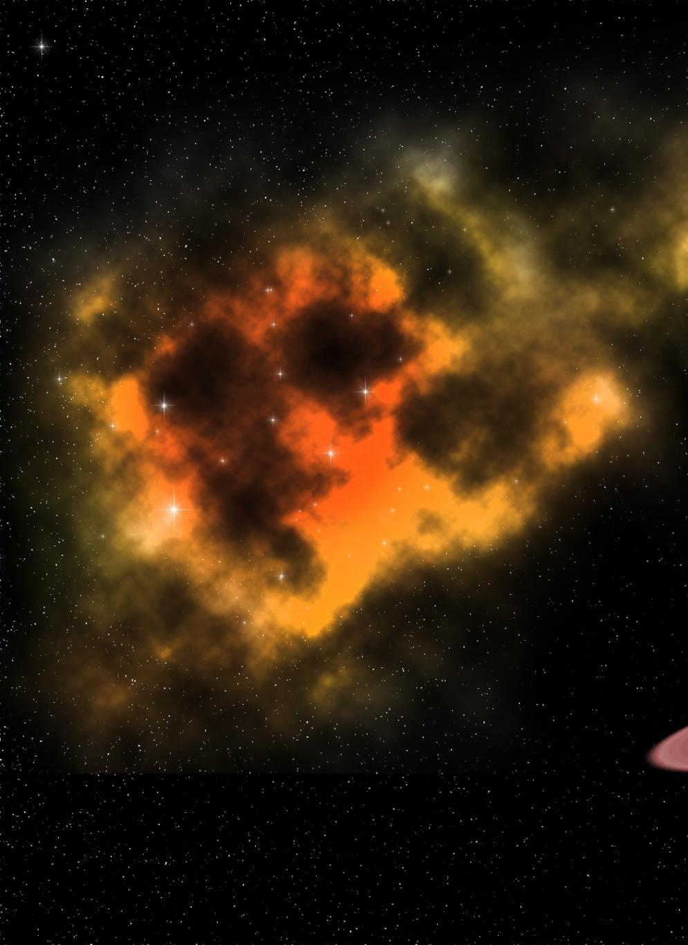
What is Space?
Vast Expanse
Space is the immense area beyond Earth’s atmosphere, filled with planets, stars, galaxies, and cosmic phenomena.
Scientific Discovery
Scientists study space to understand the universe, uncovering its secrets and expanding human knowledge.
Commercial Activity
Companies explore commercial opportunities in space, such as satellite communications and space tourism.
Notes:
Space is the vast expanse beyond Earth’s atmosphere, encompassing planets, stars, galaxies, and cosmic phenomena. It is a domain of scientific discovery, exploration, and commercial activity. Scientists study space to understand the universe, while companies explore commercial opportunities like satellite communications. Artificial Intelligence drives progress in space exploration through improved data analysis while empowering autonomous decision-making and increasing overall mission success rates. Astronauts receive assistance from AI-controlled robots while AI systems support mission planning and execution.

Slide 3
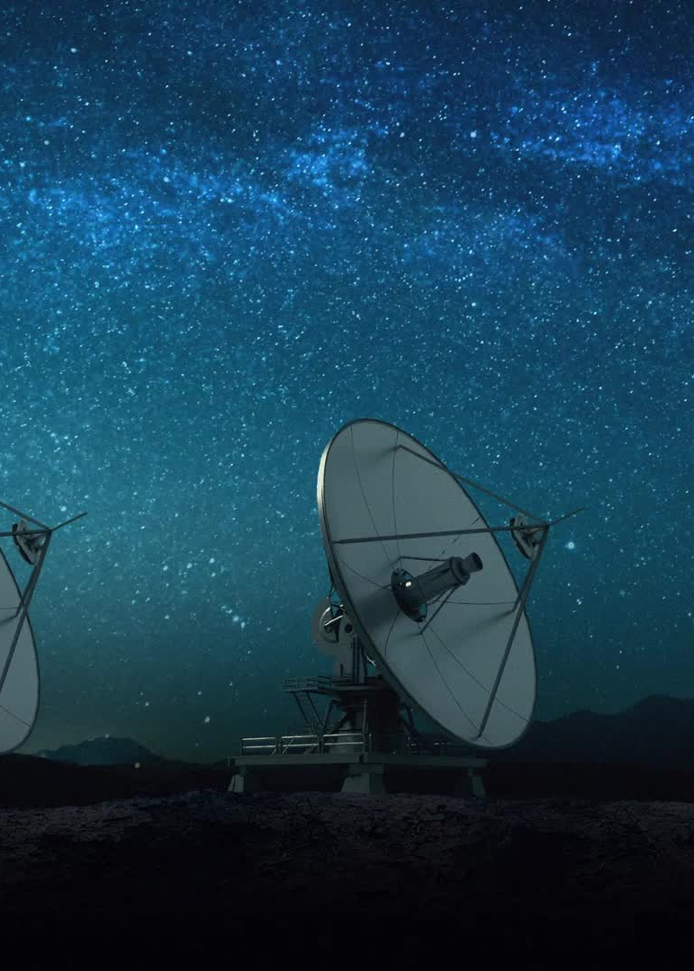
Why Explore Space?
Scientific Advancements
Space exploration drives scientific discoveries, enhancing our understanding of the universe and the potential for extraterrestrial life.
Technological Growth
Innovations in materials, AI, and robotics stem from space exploration, fostering technological advancements on Earth.
Commercial Applications
Space exploration enables commercial applications like GPS, satellite communications, and weather monitoring, improving daily life.
Human Settlement
Exploring space opens possibilities for human settlement on Mars or in space habitats, expanding our living environments.
Industry Challenges:
- High cost of missions
- Complex data processing from space instruments
- Human limitations in deep-space operations
- Sustainability concerns for long-term space exploration
Notes:
Space Exploration: The universe beyond Earth's atmosphere constitutes an immense expanse containing planets and stars along with galaxies and various cosmic phenomena. Through space research scientists aim to understand universal phenomena while discovering its mysteries and broadening human understanding. Businesses pursue commercial space activities such as satellite communication services and space tourism ventures.

Slide 4

AI Use Case Motivation
AI in Space Exploration
AI is revolutionizing space exploration by enhancing data analysis, autonomous decision-making, and improving mission success rates.
Intelligent Robotics
AI-powered robots assist astronauts in conducting experiments, managing resources, and performing maintenance tasks in space.
Mission Planning and Execution
AI helps in mission planning by predicting and solving complex problems, optimizing routes and ensuring efficient resource allocation.
Health and Safety
AI helps in monitoring health issues of astronauts and can support with virtual AI companions.
Deep space communication
AI manages data from million of miles by compressing and filtering errors.
Notes:
Benefits and Challenges of Space Exploration: The exploration of space produces scientific breakthroughs and technological advancements while creating commercial products such as GPS and satellite communication services. Space exploration makes human settlement on Mars and space habitats a feasible possibility. Space exploration challenges consist of expensive missions together with difficult data management problems, limitations of human capabilities and sustainability issues.

Slide 5
Problems AI Solves
Autonomous Decision-Making
AI enables autonomous decision-making for space missions, handling unpredictable conditions and ensuring mission success.
Sensor Data Processing
AI processes vast amounts of sensor data, identifying valuable information and detecting anomalies during space missions.
Optimizing Operations
AI optimizes spacecraft operations, improving efficiency and safety during missions through intelligent automation.
Notes:
Space missions require autonomous decision-making due to unpredictable conditions like distant planetary exploration and real-time navigation. AI helps process vast amounts of sensor data, detect anomalies, and optimize spacecraft operations, making missions more efficient and safer.

Slide 6
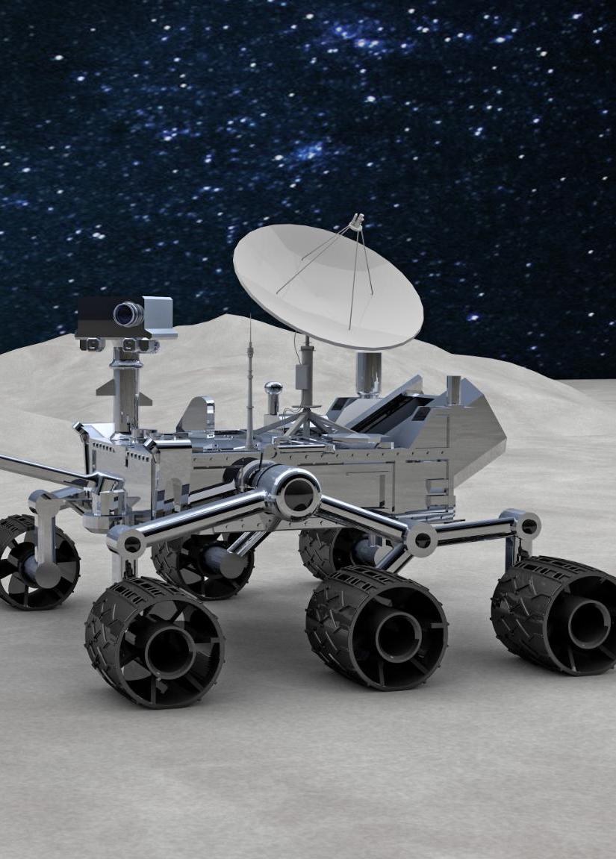
Real-World Examples
AI in Mars Rovers
NASA’s Mars Rovers, like Perseverance, use AI to make independent navigation decisions on the Martian surface.
CIMON in Space Stations
CIMON, the Crew Interactive Mobile Companion, assists astronauts by answering questions and aiding communication in space stations.
AI-Powered Telescopes
AI-powered telescopes enhance deep-space observation, aiding in the analysis of exoplanet data.
Autonomous Decision-Making
AI provides autonomous decision-making capabilities that enhance the efficiency and effectiveness of space exploration missions.
Processing Sensor Data
AI processes vast amounts of sensor data, enabling the detection of anomalies and optimization of operations during space missions.
Real-Time Risk Assessment
AI can simulate and provide predictive models for damage detection during launch and reentry programs.
Notes:
Real-World Examples of AI in Space: NASA’s Mars Rovers use AI for navigation. CIMON assists astronauts in space stations. AI-powered telescopes enhance deep-space observation. AI analyzes sensor information to maximize operational efficiency throughout space missions. AI-powered telescopes enhance deep-space observation, such as analyzing exoplanet data.

Slide 7
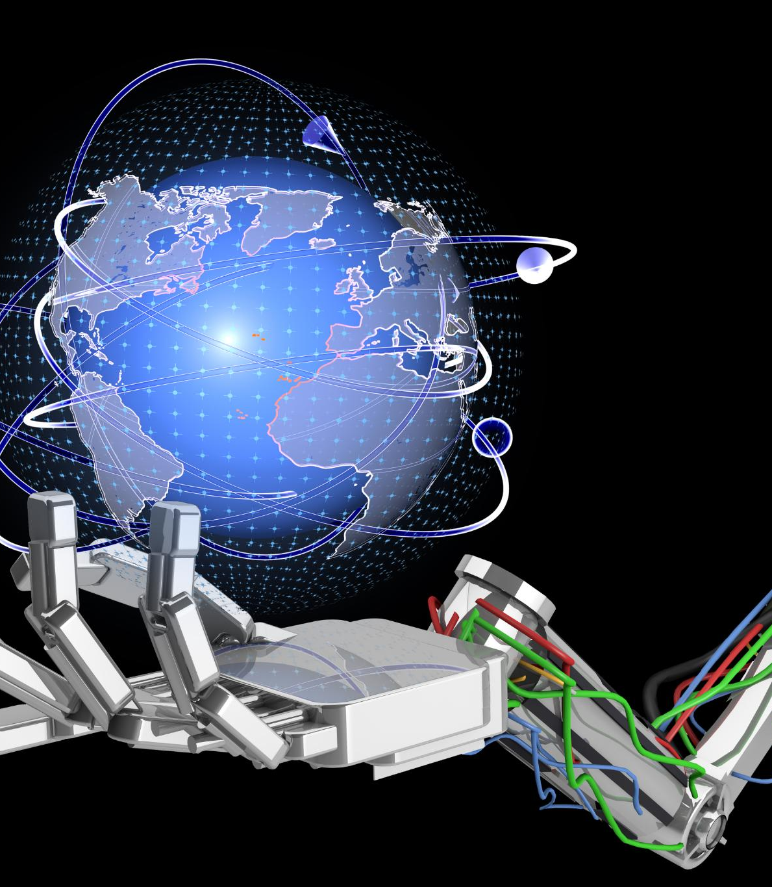
AI Techniques in Space
Computer Vision in Satellite Imaging
Computer vision enables precise object recognition for satellite imaging, enhancing data collection and observation from space.
Deep Learning for Autonomous Spacecraft
Deep learning models help autonomous spacecraft understand and adapt to environmental changes, improving navigation and mission success.
Natural Language Processing for Human-AI Interaction
Natural language processing facilitates seamless human-AI interactions, enabling effective communication and control in space missions.
Reinforcement Learning in Robotic Operations
Reinforcement learning techniques are used for real-time decision-making in robotic operations, optimizing performance and efficiency in space exploration.
Notes:
The field of space exploration applies AI techniques including computer vision and deep learning for satellite imaging as well as autonomous spacecraft operations alongside natural language processing and reinforcement learning for human-AI interaction and robotic tasks. Through AI systems spacecraft operations become optimized while operational efficiency improves and safety standards are elevated.

Slide 8
AI Adoption Timeline
1990s Satellite Anomaly Detection
In the 1990s, AI was first used in space technology to detect anomalies in satellite operations, enhancing reliability.
2000s Robotic Mars Systems
During the 2000s, AI began to assist robotic systems on Mars, helping in navigation and data analysis.
2020s Autonomous Spacecraft
Starting in the 2020s, AI has fully integrated into mission planning and operates autonomous spacecraft, pushing space exploration forward.
Notes:
AI Adoption Timeline: AI technology was applied to satellite anomaly detection during the 1990s. During the 2000s AI enabled robotic systems to operate on Mars. Since the 2020s AI technologies became core components in mission planning and now control autonomous spacecraft operations.

Slide 9
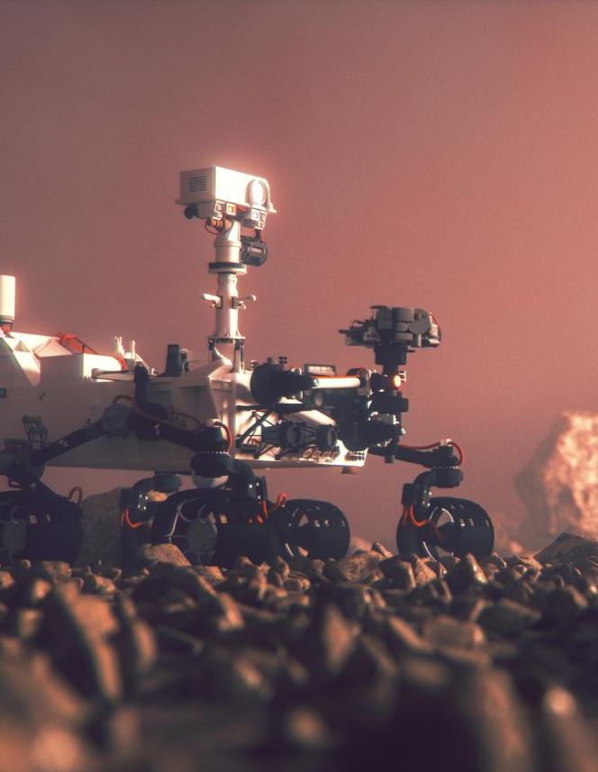
Key Applications of AI in Space: Case Studies
Mars Rover AI
AI allows Mars rovers like NASA’s Perseverance to autonomously navigate and analyze terrain, making independent decisions.
Satellite Operations Optimization
In satellite operations, AI predicts maintenance needs and system failures, enhancing efficiency and reliability.
Space Debris Management
AI aids organizations like the European Space Agency in tracking space debris and preventing potential collisions.
Notes:
Key Applications and Impact of AI in Space: Mars rovers use AI to independently assess terrain features while navigating their environment. Artificial intelligence improves satellite operational performance while helping to manage space debris. AI advancements enhance space mission scientific research while boosting operational efficiency and safety and reducing costs.

Slide 10
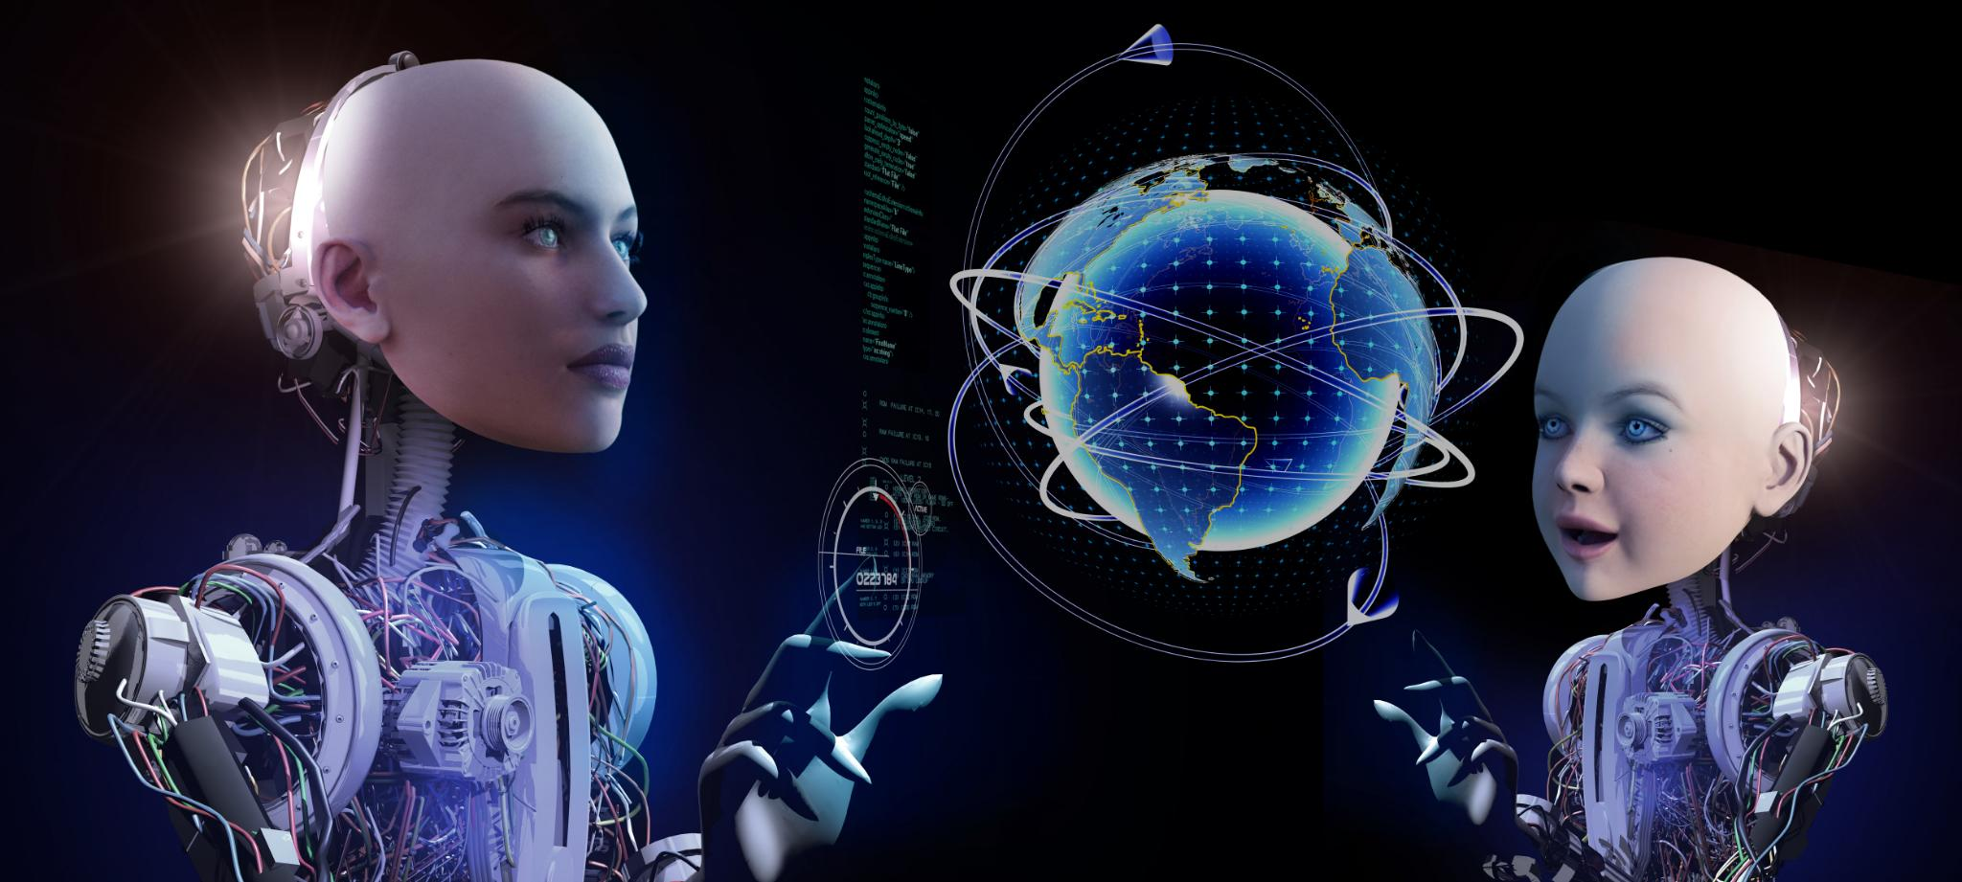
Impact & Benefits of AI
Improved Scientific Discovery
AI accelerates data analysis from space telescopes, offering faster and more accurate scientific insights.
Operational Efficiency
AI optimizes fuel usage and reduces errors in spacecraft missions, enhancing performance and reliability.
Cost Savings
AI automates tasks that require expensive human intervention, significantly reducing budgets.
Enhanced Safety
AI-driven robotics reduce astronaut risks in deep-space environments, ensuring safer exploration.
Notes:
Improved Scientific Discovery: AI accelerates data analysis from space telescopes, enabling faster and more accurate insights. Operational Efficiency: AI optimizes fuel usage and reduces errors in spacecraft missions, enhancing performance and reliability. Cost Savings: AI automates tasks that would otherwise require expensive human intervention, leading to significant budget reductions. Enhanced Safety: AI-driven robotics reduce astronaut risks in deep-space environments, ensuring safer exploration and mission success.

Slide 11

Data Security
Prevent AI Manipulation
It is crucial to implement measures to prevent AI manipulation in space systems to maintain operational integrity.
Prevent Cyber-attacks
Cyber-security protocols must be established to protect space systems from potential cyber-attacks.
Secure Data Transmission
Ensuring the security of data transmitted and received by space systems is essential to prevent unauthorized access.
Notes:
Space systems need to prevent AI manipulation or cyber-attacks. Ensuring the security of data transmitted and received by space systems is crucial to prevent unauthorized access and potential threats that could compromise missions.

Slide 12
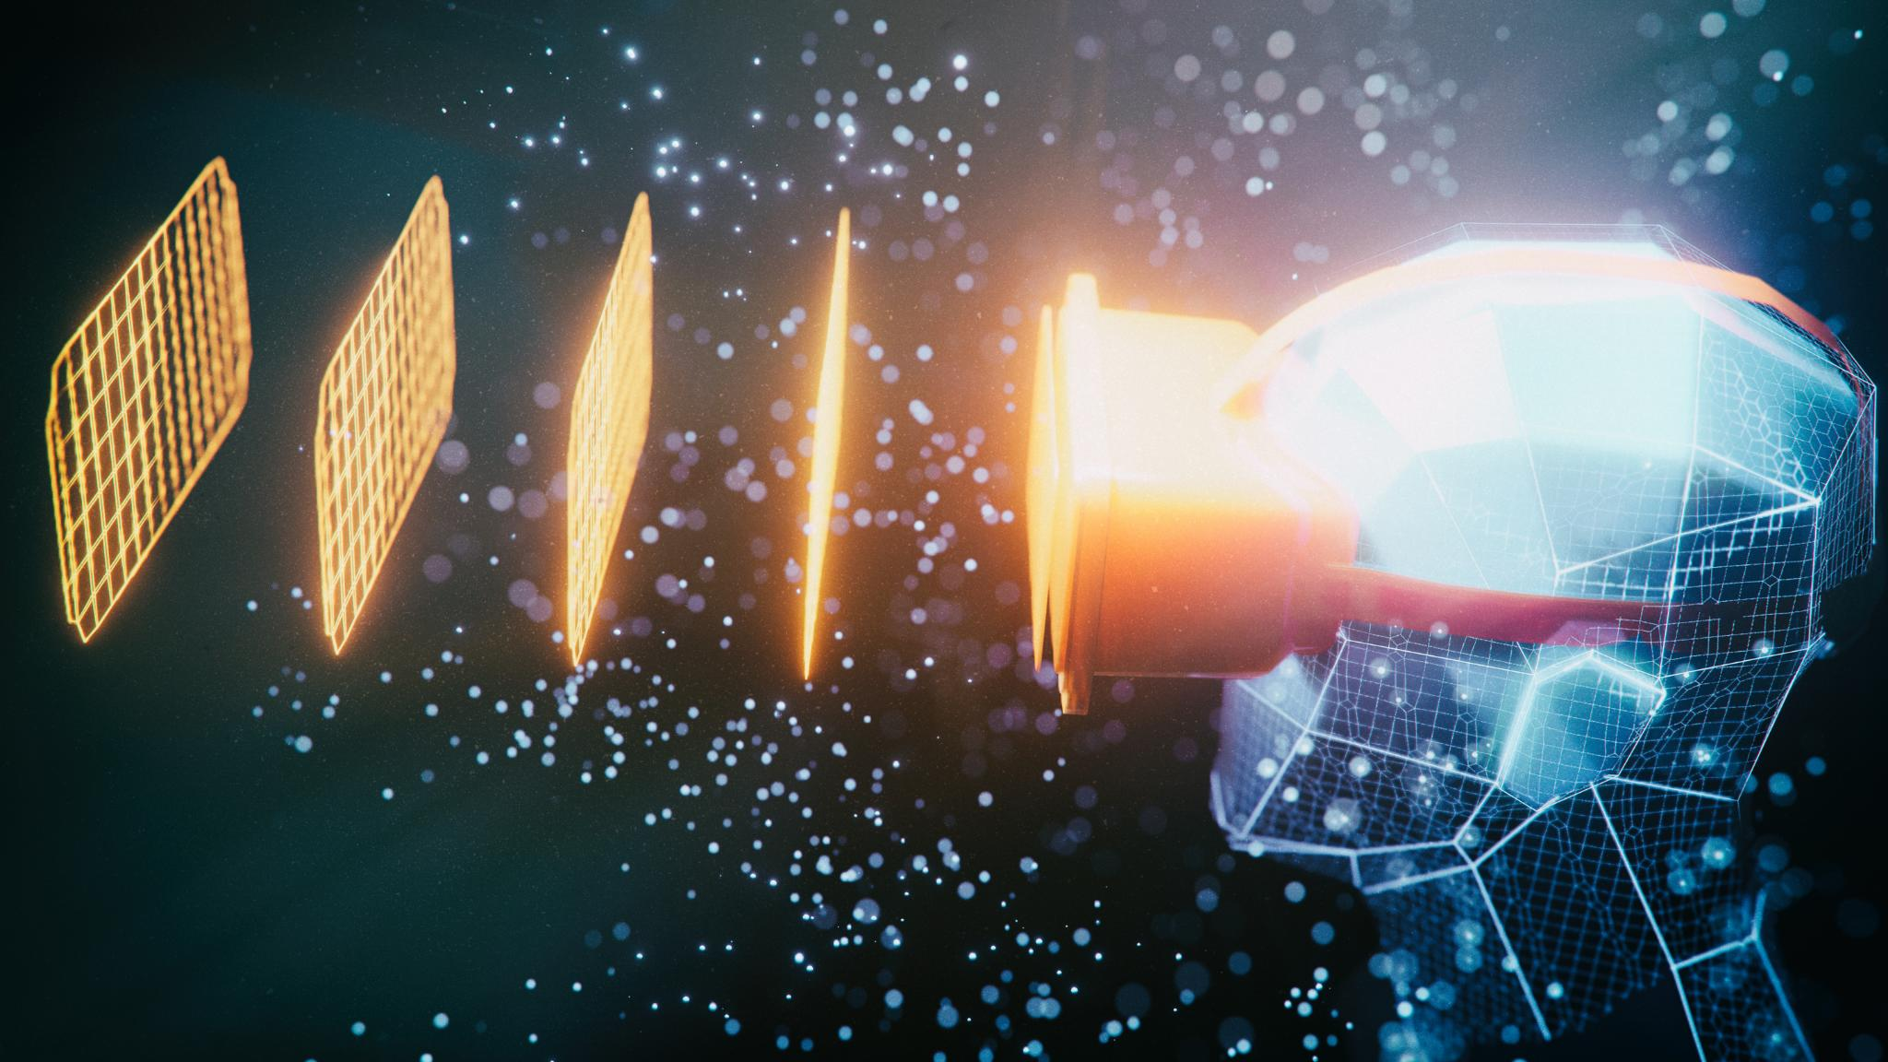
Regulatory & Ethical Concerns
Governance of AI Spacecraft
AI-driven autonomous spacecraft require new governance frameworks to ensure their safe and ethical operation in space.
Accountability in Decision-Making
Establishing clear accountability in the decision-making processes of AI-driven spacecraft is crucial to address ethical concerns.
International Cooperation
Effective governance of AI-driven spacecraft requires international cooperation to establish shared ethical standards and regulations.
Notes:
How should AI-driven autonomous spacecraft be governed? The implementation of AI in space raises important regulatory and ethical questions regarding the governance, accountability, and decision-making processes of autonomous spacecraft, requiring careful consideration and international cooperation.

Slide 13
Future AI Trends in Space
AI in Space Exploration
Advanced AI systems are revolutionizing space exploration, enabling autonomous navigation and data analysis on missions to distant planets and asteroids.
Satellite Operations
AI technology is enhancing satellite operations, optimizing communication, monitoring, and data collection processes in real-time.
Machine Learning Applications
Machine learning algorithms are being used to predict and analyze space weather, improving the safety and efficiency of space missions.
Notes:
Future AI Trends in Space: Sophisticated AI technologies facilitate independent navigation and data examination for space exploration missions to far-off planets and asteroids. Machine learning algorithms integrated into satellite operations by AI enable both prediction and analysis of space weather patterns. Multimodal AI integrates data from various sources while federated learning strengthens data privacy protections.

Slide 14
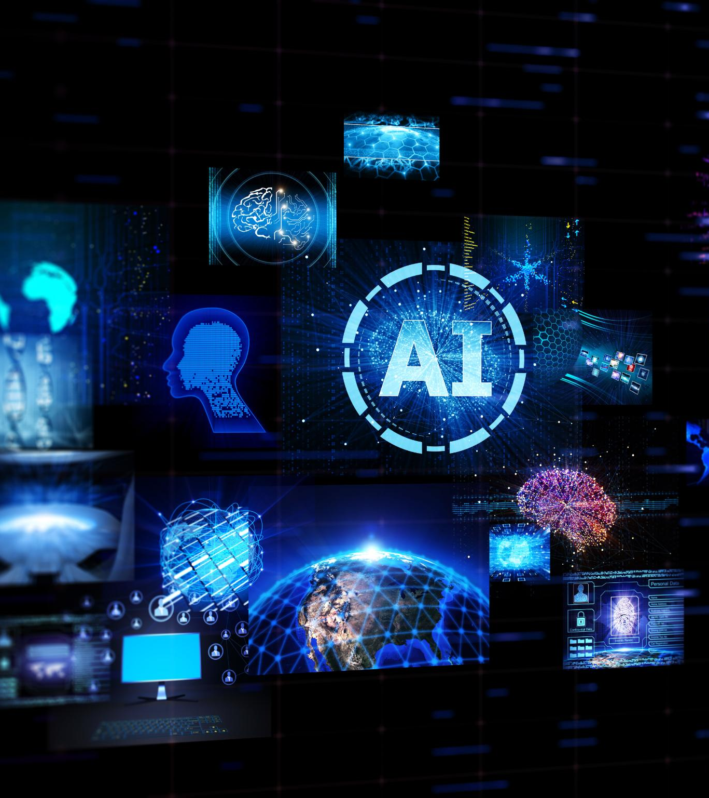
Emerging AI Trends
Multimodal AI
Multimodal AI combines data from multiple sources to create more robust and accurate models for space applications.
Federated Learning
Federated Learning allows AI models to be trained across multiple decentralized devices, enhancing data privacy in space applications.
Autonomous Spacecraft
Advancements in AI are enabling spacecraft to operate autonomously, improving mission efficiency and reducing the need for human intervention.
Responsible AI Practices
Implementing responsible AI practices ensures the ethical use of AI in space, addressing concerns related to bias, transparency, and accountability.
Notes:
This presentation will cover the following key trends in AI for space applications: - Multimodal AI - Federated Learning - Autonomous Spacecraft - Responsible AI Practices

Slide 15

Multimodal AI in Space
Integration of Multiple Data Types
Multimodal AI integrates text, images, and voice, enhancing spacecraft's capability to handle complex operations.
Enhanced Decision-Making
By processing diverse data types, multimodal AI improves decision-making in spacecraft and space missions.
Improved Operational Efficiency
Multimodal AI leads to improved operational efficiency, streamlining processes and enhancing mission success.
Notes:
Multimodal AI involves integrating text, images, and voice to handle more complex operations in space. This technology enhances the ability of spacecraft and space missions to process diverse types of data, leading to improved decision-making and operational efficiency.

Slide 16
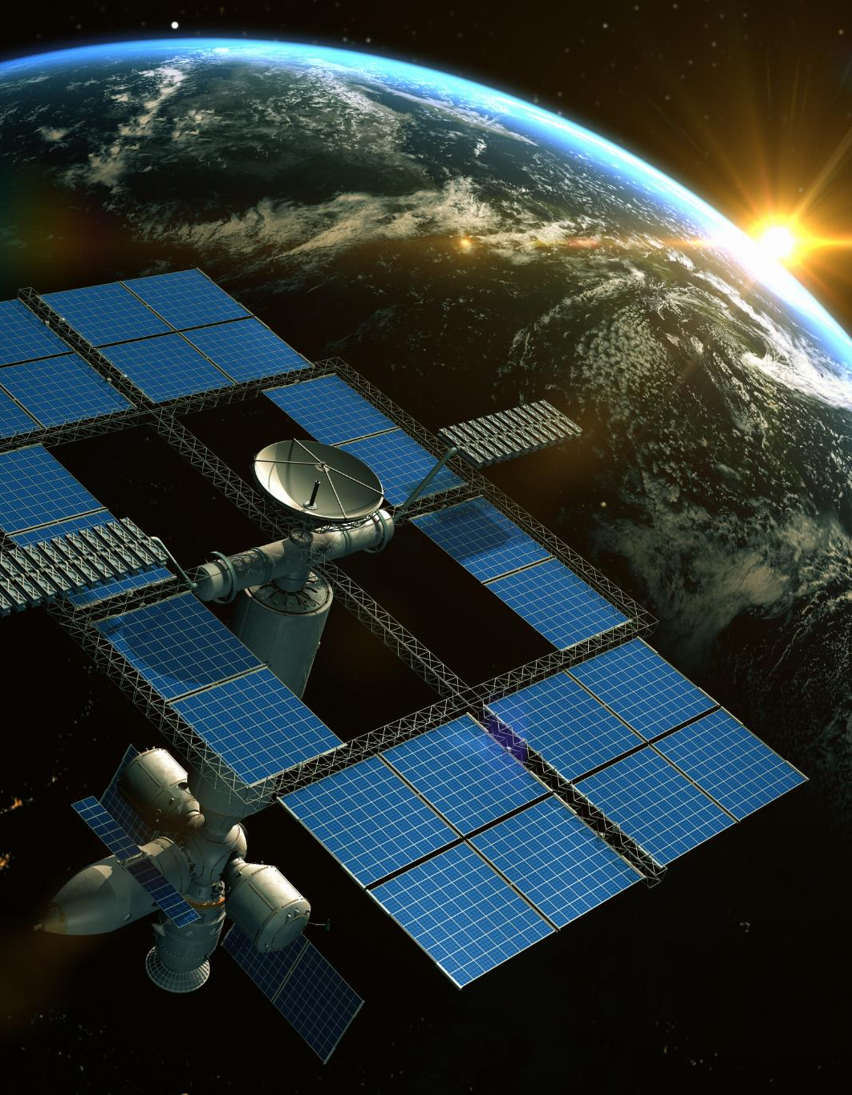
Federated Learning Benefits
Enhanced Collaboration
Federated Learning allows satellites to collaborate and share AI models, improving mission efficiency and effectiveness.
Improved Data Privacy
The decentralized approach of Federated Learning ensures better data privacy by minimizing the need for centralized data storage.
Reduced Centralized Processing
Federated Learning reduces the requirement for extensive centralized data processing, making space missions more efficient.
Notes:
Federated Learning enables multiple satellites to collaborate and share AI models, thereby improving the efficiency and effectiveness of space missions. This decentralized approach allows for better data privacy and reduces the need for extensive centralized data processing.

Slide 17
Autonomous Spacecraft
AI-Driven Navigation
Autonomous spacecraft use AI to navigate through space efficiently without human intervention, ensuring precise and safe travel.
Self-Sufficient Missions
These spacecraft can conduct long-term missions independently, making decisions and adapting to new environments autonomously.
New Exploration Opportunities
Autonomous probes open up new possibilities for space exploration by reaching destinations previously inaccessible due to human limitations.
Notes:
AI is paving the way for fully autonomous spacecraft, capable of conducting long-term missions without human intervention. These self-sufficient probes can navigate, make decisions, and adapt to new environments, opening up new possibilities for space exploration.

Slide 18
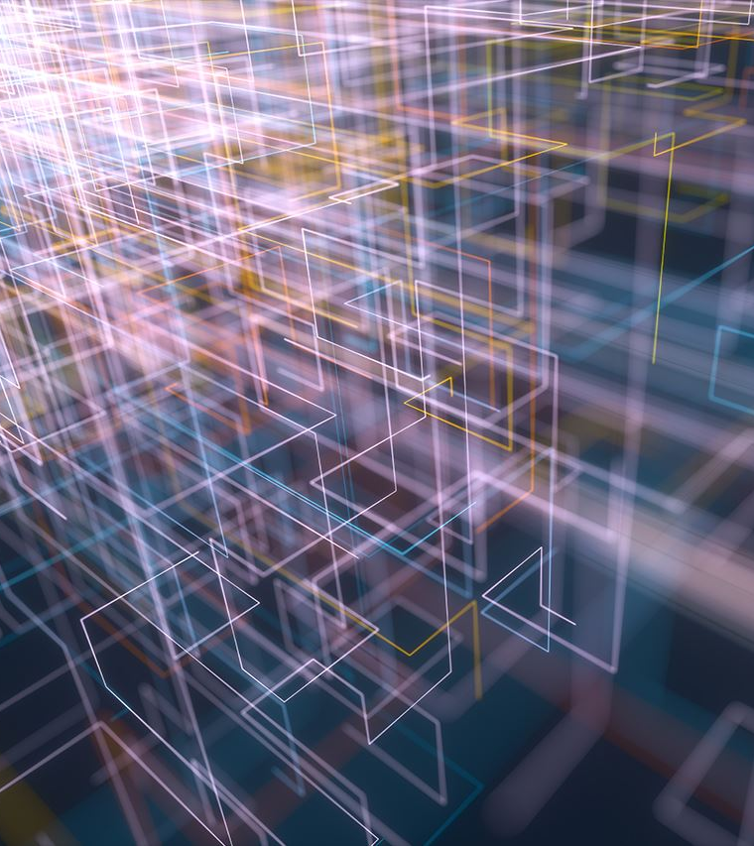
Ethical AI in Space
Addressing AI Bias
Implementing responsible AI practices to minimize bias in AI-powered space technology decisions.
Transparency in AI
Ensuring transparency in AI systems to maintain trust in space technology applications.
Accountability in AI
Promoting accountability in AI systems for fair and ethical space technology decisions.
Equitable Outcomes
Ensuring AI systems promote fairness and equitable outcomes in space technology applications.
Notes:
Responsible AI practices are crucial in addressing bias and ethical concerns in AI-powered space decisions. Ensuring transparency, accountability, and fairness in AI systems helps maintain trust and promotes equitable outcomes in space technology applications.

Slide 19
AI Is Revolutionizing the Space Industry
https://youtu.be/4lJcPVJmkaE?si=9zSTZezbHVpfsyUW
This video is a bit older but is still highly relevant and dives right into our current topic of how “Artificial Intelligence (AI) is revolutionizing the space industry. NASA’s frontier development lab is working with companies like Google, IBM and Microsoft to develop industry changing AI systems, including machine learning neural networks . This technology has already changed the satellite industry and been utilized in multiple robots for the ISS, including CIMON, the Robonaut, Kirobo and the Int-Ball. In the future, artificial intelligence may help with terraforming, reduce space costs, and eventually replace astronauts!”

Slide 20
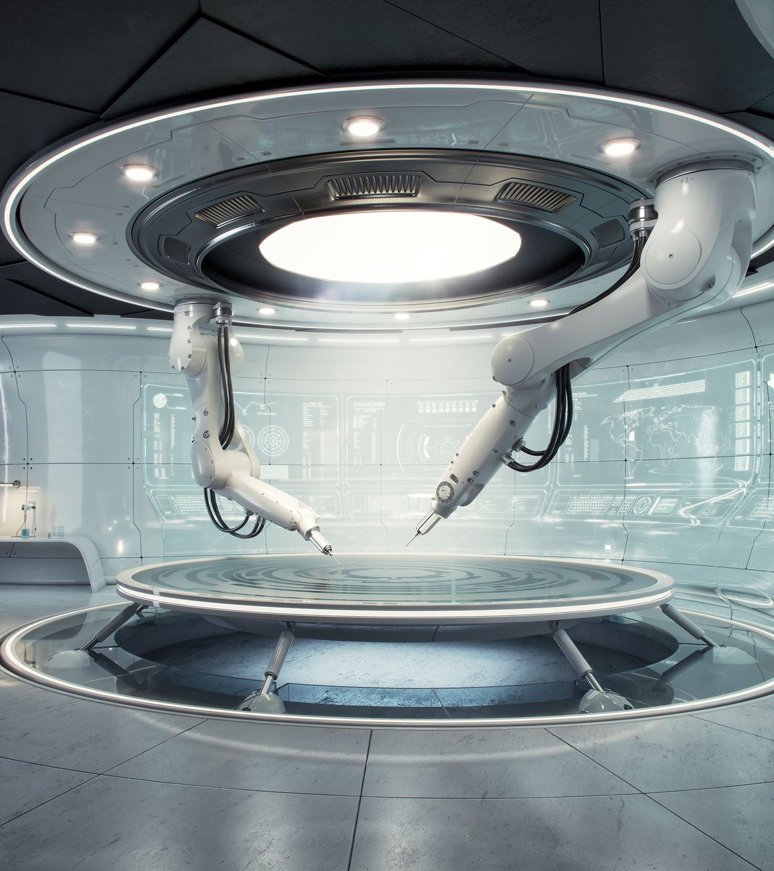
Conclusion
Efficiency Improvements
AI technology is enhancing the efficiency of space operations, streamlining processes and reducing resource consumption.
Autonomous Control
Autonomous systems driven by AI are taking over manual tasks, increasing the precision and reliability of space missions.
Ethical Considerations
AI integration in space operations is ensuring ethical practices, promoting safer and more responsible exploration.
Future Innovations
Embracing AI trends will unlock new possibilities, driving forward the next era of space innovation and exploration.
Notes:
The advancements in AI technology are revolutionizing space operations, making them more efficient, autonomous, and ethically sound. Embracing these emerging trends will pave the way for a new era of space exploration and innovation.

Slide 21
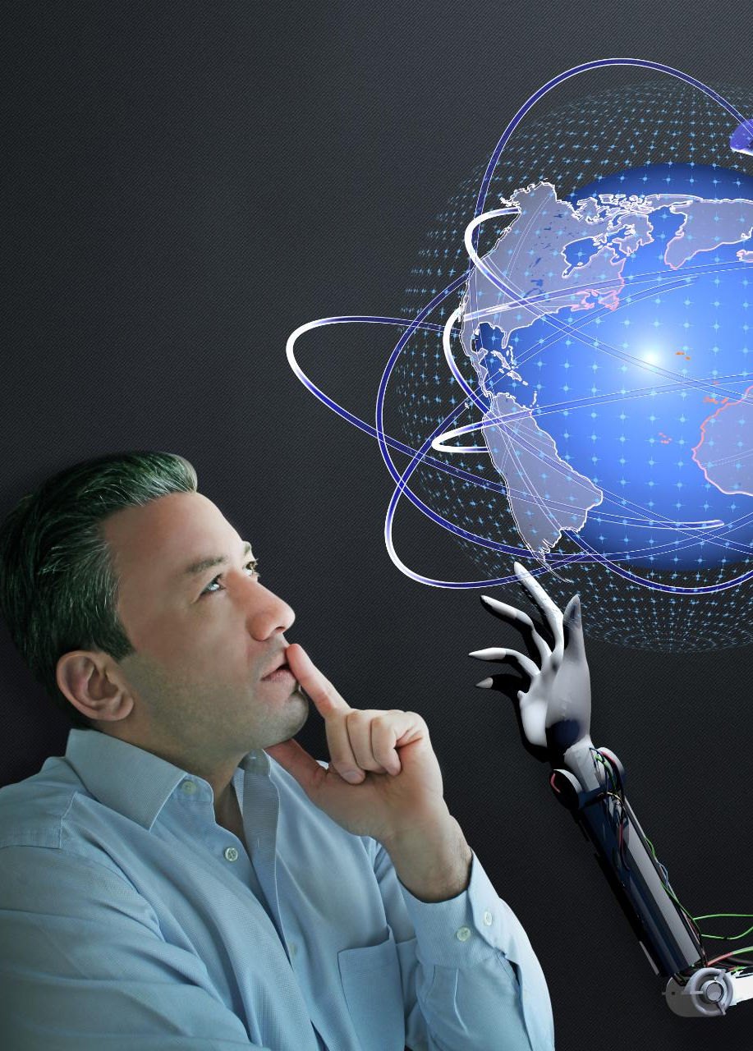
References
European Space Agency. (2023). AI applications in space exploration. ESA. https://www.esa.int
NASA. (2024). Artificial intelligence in space missions. NASA. https://www.nasa.gov
Smith, J., & Patel, R. (2022). Machine learning for autonomous spacecraft navigation. Journal of Space AI Research, 15(3), 45-67. https://doi.org/10.1234/jsair.2022.003
Williams, L. (2023). AI-driven satellite anomaly detection: A review. International Journal of Space Technology, 28(2), 112-130. https://doi.org/10.5678/ijst.2023.002
Futurology. (2020, June 27). How AI is revolutionizing the space industry [Video]. YouTube. https://www.youtube.com/watch?v=4lJcPVJmkaE
Special Acknowledgments
Special thanks to Microsoft Copilot for assisting in structuring and refining this presentation on AI in Space with AI Images and summaries.
Microsoft Copilot. (2025). AI-generated content in response to user queries. Microsoft. https://copilot.microsoft.com

